Slide 1

Chapter 3:
Describing Data Numerically
^{Discovering Statistics}
^{2nd Edition Daniel T. Larose}
Lecture PowerPoint Slides
Notes:
Basic Practice of Statistics - 3rd Edition
Chapter 5

Slide 2
Chapter 3 Overview
3.1 Measures of Center
3.2 Measures of Variability
3.3 Working with Grouped Data
3.4 Measures of Position and Outliers
3.5 The Five-Number Summary and Boxplots
3.6 Chebyshev’s Rule and the Empirical Rule

Slide 3


The Mean
The most well-known and widely used measure of center is the mean. In everyday usage, the word average is often used for mean.
To find the mean of the values in a data set, simply add up all the numbers and divide by how many numbers you have.
Notation:
The sample size (how many observations in the data set) is always denoted by n.
The i^{th} data value is denoted by x_{i}, where i is an index or counter indicating which data point we are specifying.
The notation for “add them together” is Σ(capital sigma), the Greek letter “S,” because it stands for “Summation.”
The sample mean is called (pronounced “x-bar”).
The sample mean can be written as . In plain English, this just means that, in order to find the mean, we
Add up all the data values, giving us Σx
Divide by how many observations are in the data set, giving us

Slide 4
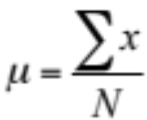
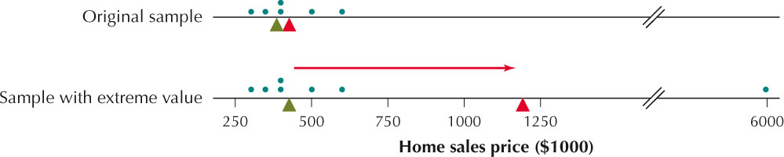
The Population Mean
The mean value of the population is usually unknown. We denote the population mean with µ (mu), which is the Greek letter “m.” The population size is denoted by N.
When all the values of the population are known, the population mean is calculated as
We can use the sample mean as an estimate of µ. Note, however, different samples may yield different sample means.
One drawback to using the mean to measure the center of the data is that the mean is sensitive to the presence of extreme values in the data set.

Slide 5
The Median
In statistics, the median of a data set is the middle data value when the data are put into ascending order.
The Median
The median of a data set is the middle data value when the data are put into ascending order. Half of the data values lie below the median, and half lie above.
If the sample size n is odd, then the median is the middle value.
If the sample size n is even, then the median is the mean of the two middle data values.
Unlike the mean, the median is not sensitive to extreme values.

Slide 6
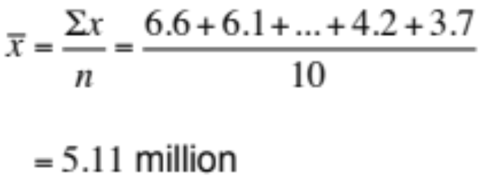
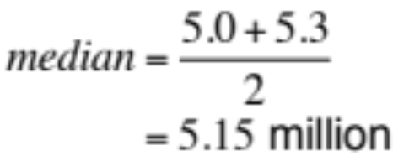
The Mode
A third measure of center is called the mode. In a data set, the mode is the value that occurs the most.
The mode of a data set is the data value that occurs with the greatest frequency.
Rank | Person | Followers (millions)
1 | Lady Gaga | 6.6
2 | Britney Spears | 6.1
3 | Ashton Kutcher | 5.9
4 | Justin Bieber | 5.6
5 | Ellen DeGeneres | 5.3
6 | Kim Kardashian | 5.0
7 | Taylor Swift | 4.4
8 | Oprah Winfrey | 4.4
9 | Katy Perry | 4.2
10 | John Mayer | 3.7
Sample Mean
Median
Mode
Two people have 4.4 million followers. 4.4 million is the mode.

Slide 7
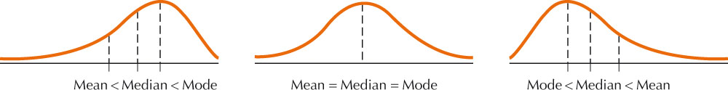
Skewness and Measures of Center
The skewness of a distribution can often tell us something about the relative values of the mean, median, and mode.
How Skewness Affects the Mean and Median
For a right-skewed distribution, the mean is larger than the median.
For a left-skewed distribution, the median is larger than the mean.
For a symmetric unimodal distribution, the mean, median, and mode are fairly close to one another.

Slide 8
3.2: Measures of Variability
Objectives:
Understand and calculate the range of a data set.
Explain in my own words what a deviation is.
Calculate the variance and the standard deviation for a population or a sample.

Slide 9
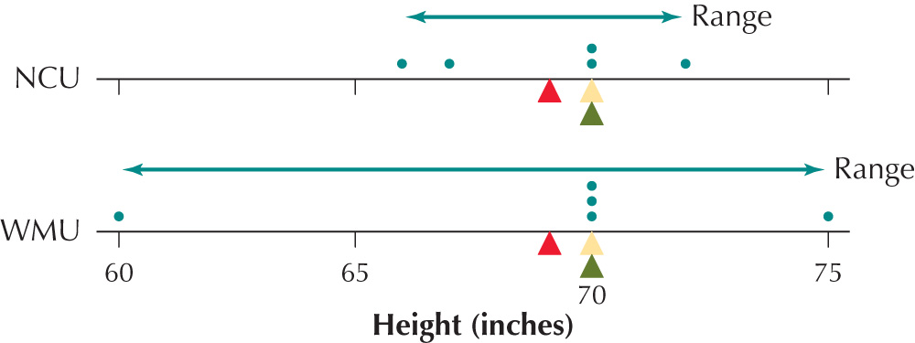
The Range
Section 3.1 introduced ways to find the center of a data set. Two data sets can have exactly the same mean, median, and mode and yet be quite different. We need measures that summarize the variation, or variability, of the data.
Women’s Volleyball Team Heights (in)
Western Massachusetts Univ | Northern Connecticut Univ
60 | 66
70 | 67
70 | 70
70 | 70
75 | 72

Slide 10
The Range
There are a variety of ways to measure how spread out a data set is. The simplest measure is the range.
The range of a data set is the difference between the largest value and the smallest value in the data set:
range = largest value – smallest value
Women’s Volleyball Team Heights (in)
Western Massachusetts Univ | Northern Connecticut Univ
60 | 66
70 | 67
70 | 70
70 | 70
75 | 72
range_{WMU} = 75 – 60 = 15 inches
range_{NCU} = 72 – 66 = 6 inches

Slide 11
What is Deviation?
The range is simple to calculate, but has its drawbacks. It is quite sensitive to extreme values and it completely ignores all of the values in the data set other than the extremes. The standard deviation quantifies spread with respect to the center and uses all available data values.
Deviation
A deviation for a given data value x is the difference between the data value and the mean of the data set. For a sample, the deviation equals x – x-bar. For a population, the deviation equals x – µ.
If the data value is larger than the mean, the deviation will be positive.
If the data value is smaller than the mean, the deviation will be negative.
If the data value equals the mean, the deviation will be zero.
The deviation can roughly be thought of as the distance between a data value and the mean, except that the deviation can be negative while distance is always positive.

Slide 12
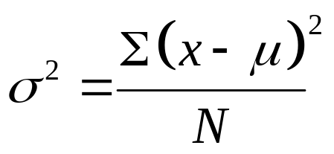
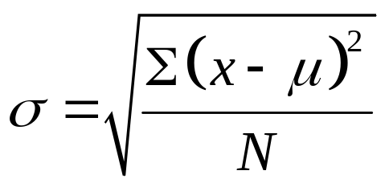
The Variance and Standard Deviation
To compute the standard deviation and variance, we consider the squared deviations. It is logical to build our measure of spread using the mean squared deviation.
The population variance σ² is the mean of the squared deviations in the population given by the formula
The population standard deviation σ is the positive square root of the population variance and is found by
The population standard deviation σ represents a distance from the mean that is representative for that data set.

Slide 13
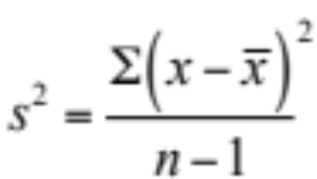
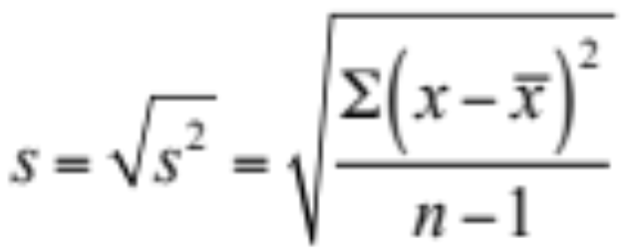
The Sample Variance and Sample Standard Deviation
In the real world, we use the sample mean and sample standard deviation to estimate the population parameters. The sample variance also depends on the concept of the mean squared deviations. However, we replace the denominator with n – 1 to better estimate the parameter.
The sample variance s² is approximately the mean of the squared deviations in the sample given by the formula
The sample standard deviation s is the positive square root of the sample variance and is found by
The value of s may be interpreted as the typical difference between a data value and the sample mean for a given data set.

Slide 14
3.3: Working with Grouped Data
Objectives:
Calculate the weighted means.
Estimate the mean for grouped data.
Estimate the variance and standard deviation for grouped data.

Slide 15
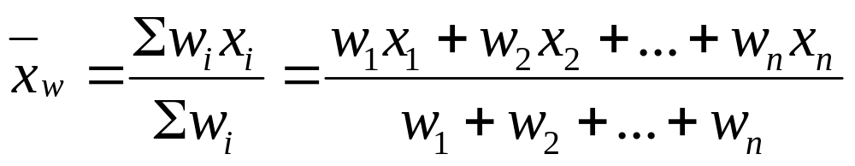
The Weighted Mean
Sometimes not all the data values in a data set are of equal importance. Certain data values may be assigned greater weight than others when calculating the mean.
Weighted Mean
To find the weighted mean:
Multiply each data point x_{i} by its respective weight w_{i}.
Sum these products.
Divide the result by the sum of the weights:

Slide 16
3.4: Measures of Position and Outliers
Objectives:
Calculate z-scores and explain why we use them.
Detect outliers using the z-score method.
Find percentiles and percentile ranks for both small and large data sets.
Computer quartiles and the interquartile range.

Slide 17
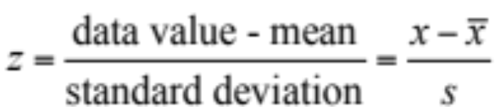
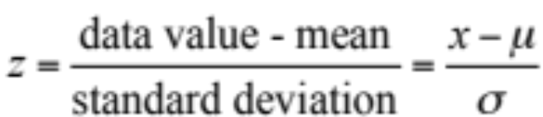
z-Scores
Our first measure of position is the z-score. The term z-score indicates how many standard deviations a particular data value is from the mean.
z-Score
The z-score for a particular data value from a sample is
The z-score for a particular data value from a population is

Slide 18
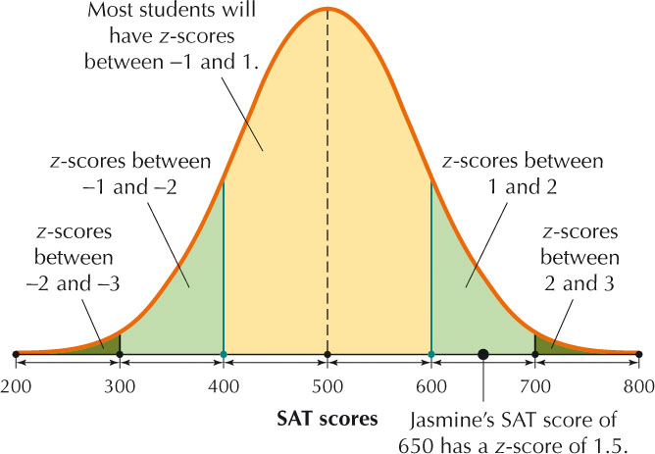
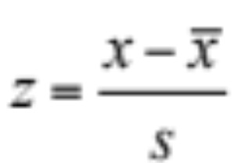
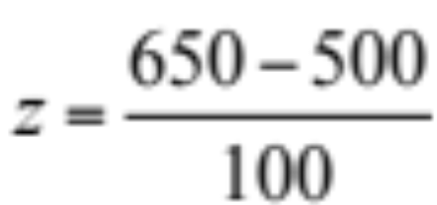

z-Scores
Suppose the mean score on the Math SAT is µ = 500, with a standard deviation of σ = 100 points.
Jasmine’s Math SAT score is 650. What is her z-score?
Jasmine

Slide 19


z-Scores
In some cases, we may be given a z-score and asked to find its associated data value x.
Given a z-score, to find its associated value x:
For a sample:
For a population:
where µ is the population mean, x-bar is the sample mean, σ is the population standard deviation, and s is the sample standard deviation.
z-scores can also be used to compare data from different data sets. That is, relative positions can be compared even when the means and standard deviations of the data sets are different.

Slide 20
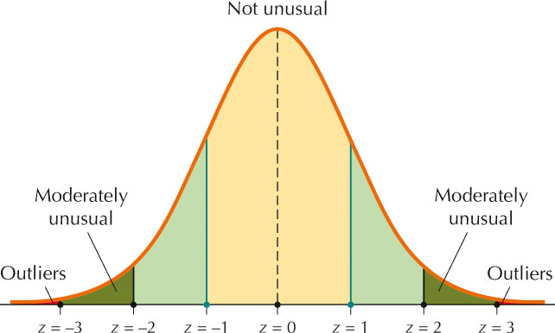
Detecting Outliers with z-Scores
An outlier is an extremely large or extremely small data value relative to the rest of the data set. It may represent a data entry error, or it may be genuine data.
Guidelines for Identifying Outliers
A data value whose z-score lies in the following range is not considered to be unusual:
-2 < z-score < 2
A data value whose z-score lies in the following range may be considered moderately unusual:
-3 < z-score ≤ -2 or 2 ≤ z-score < 3
A data value whose z-score lies in the following range may be considered an outlier:
z-score ≤ -3 or : z-score ≥ 3

Slide 21
Percentiles and Percentile Ranks
The next measure of position we consider is the percentile, which shows the location of a data value relative to the other values in the data set.
Percentile
Let p be any integer between 0 and 100. the p^{th} percentile of a data set is the data value at which p percent of the values in the data set are less than or equal to the value.
Percentile
The percentile rank of a data value x equals the percentage of values in the data set that are less than or equal to x. In other words:

Slide 22
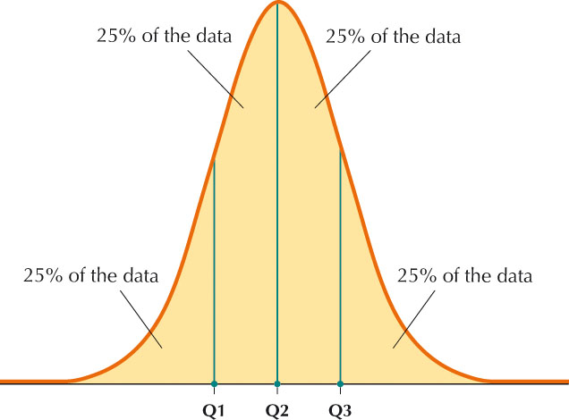
Quartiles
Just as the median divides the data set into halves, the quartiles are the percentiles that divide the data set into quarters.
Quartiles
The quartiles of a data set divide the data set into four parts, each containing 25% of the data.
The first quartile (Q1) is the 25th percentile.
The second quartile (Q2) is the 50th percentile.
The third quartile (Q3) is the 75th percentile.
For small data sets, the division may be into four parts of only approximately equal size.

Slide 23
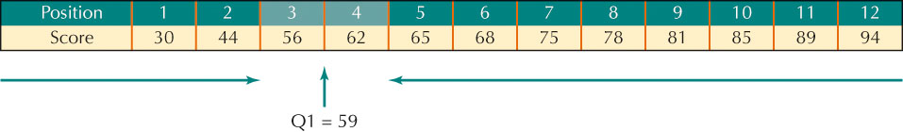
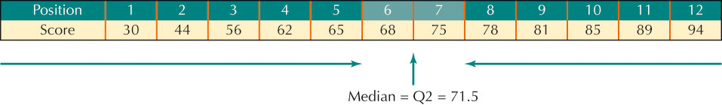
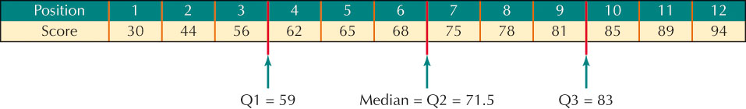
Quartiles
Find the quartiles of the dance scores of the 12 students on page 129:
First, arrange them in order from smallest to largest:
30 44 56 62 65 68 75 78 81 85 89 94

Slide 24
Interquartile Range
The variance and standard deviations are measures of spread that are sensitive to the presence of extreme values. A more robust (less sensitive) measure of variability is the interquartile range.
Interquartile Range
The interquartile range (IQR) is a robust measure of variability. It is calculated as: IQR = Q3 – Q1.
The interquartile range is interpreted to be the spread of the middle 50% of the data.
IQR = 83 – 59 = 24

Slide 25
3.5: Five-Number Summary and Boxplots
Objectives:
Calculate the five-number summary of a data set.
Construct and interpret a boxplot for a given data set.
Detect outliers using the IQR method.

Slide 26
The Five-Number Summary
One robust (or resistant) method of summarizing data that is used widely is called the five-number summary. The set consists of five measures we have already seen.
The five-number summary consists of the following set of statistics, which together constitute a robust summarization of a data set:
Minimum; the smallest value in the data set
First quartile, Q1
Median, Q2
Third quartile, Q3
Maximum, the largest value in the data set
Min=30
Max=94

Slide 27
The Boxplot
The boxplot is a convenient graphical display of the five-number summary of a data set.
Constructing a Boxplot by Hand
Determine the lower and upper fences:
Lower fence = Q1 – 1.5(IQR)
Upper fence = Q3 + 1.5(IQR)
Draw a horizontal number line that encompasses the range of your data, including the fences. Draw vertical lines at Q1, the median, and Q3. Connect the lines for Q1 and Q3 to form a box.
Temporarily indicate the fences with brackets [ and ].
Draw a horizontal line from Q1 to the smallest value greater than the lower fence. Draw a horizontal line from Q3 to the largest value smaller than the upper fence.
Indicate any data values smaller than the lower fence or larger than the upper fence using an asterisk *.

Slide 28
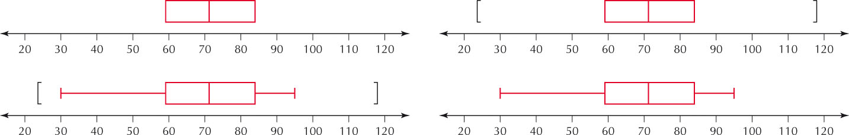
The Boxplot
Min=30
Max=94
IQR = 83 – 59 = 24
Lower fence = 59– 1.5(24) = 23
Upper fence = 83 + 1.5(24) = 119

Slide 29
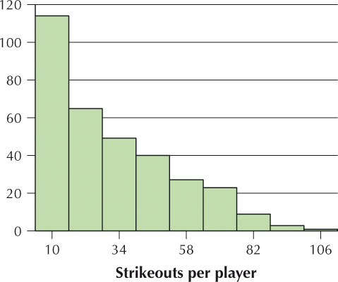
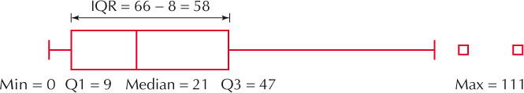
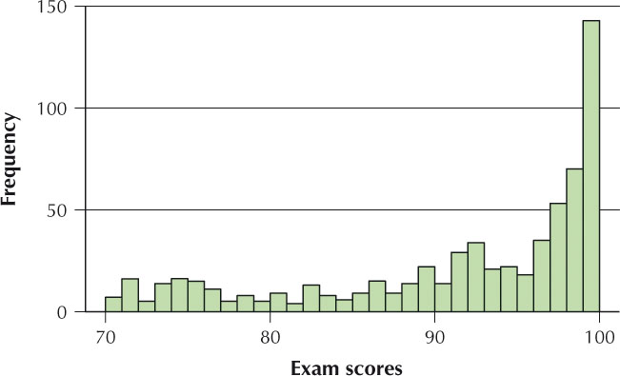
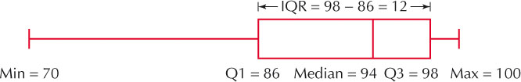
Boxplots for Skewed Data

Slide 30
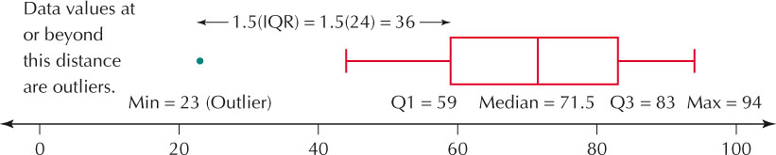
Detecting Outliers with the IQR
The mean and standard deviation are sensitive to outliers. We can use a more robust method of detecting outliers by using the IQR.
IQR Method to Detect Outliers
A data value is an outlier if
it is located 1.5(IQR) or more below Q1, or
it is located 1.5(IQR) or more above Q3.

Slide 31
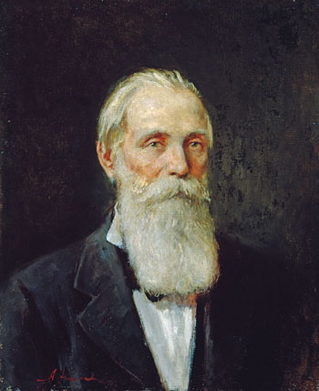
3.6: Chebyshev’s Rule and the Empirical Rule
Objectives:
Calculate percentages using Chebyshev’s Rule.
Find percentages and data values using the Empirical Rule.

Slide 32
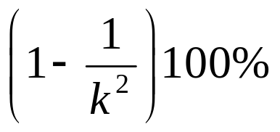
Chebyshev’s Rule
P.L. Chebyshev derived a result, called Chebyshev’s Rule, which can be applied to any continuous data set whatsoever.
Chebyshev’s Rule
The proportion of values from a data set that will fall within k standard deviations of the mean will be at least
where k > 1. Chebyshev’s Rule may be applied to either samples or populations. For example:
k = 2. At least 3/4 (or 75%) of the data values will fall within 2 standard deviations of the mean.
k = 3. At least 8/9 (or 88.89%) of the data values will fall within 3 standard deviations of the mean.

Slide 33
The Empirical Rule
When the data distribution is bell-shaped, the Empirical Rule outperforms Chebyshev.
The Empirical Rule
If the data distribution is bell-shaped:
About 68% of the data values will fall within 1 standard deviation of the mean.
About 95% of the data values will fall within 2 standard deviations of the mean.
About 99.7% of the data values will fall within 3 standard deviations of the mean.
Stated in terms of z-scores:
About 68% of the data values will have z-scores between -1 and 1.
About 95% of the data values will have z-scores between -2 and 2.
About 99.7% of the data values will have z-scores between -3 and 3.

Slide 34
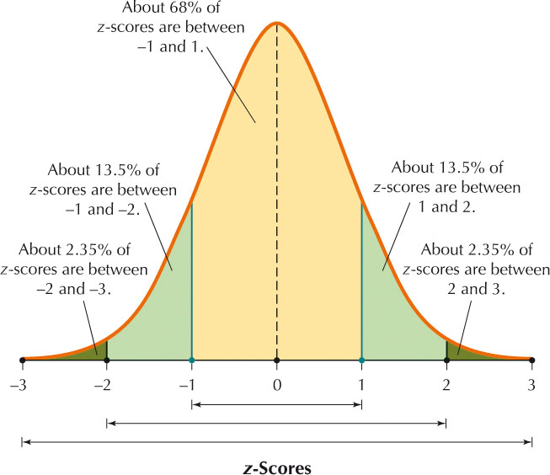
The Empirical Rule

